Slide 1
Algorithmic and High-Frequency Trading Reinforcement Learning & Trading Challenges
Ken Liu

Slide 2
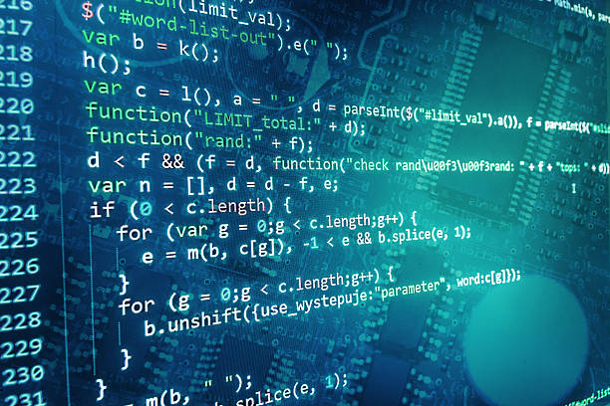
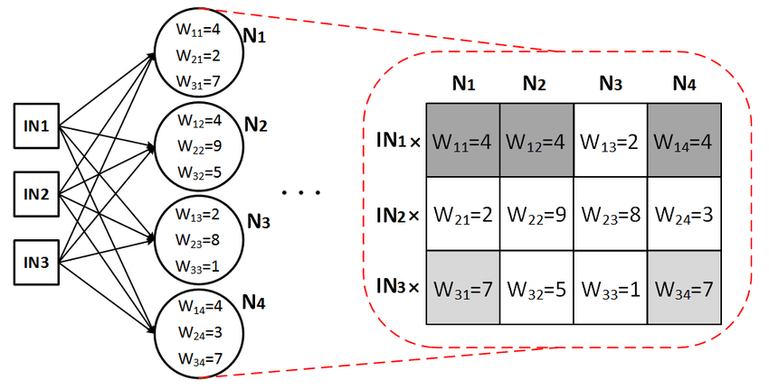
Summary of Machine Learning
Computer Programs
Human Programs

Slide 3

Machine Learning – Over fit / Under fit
Under fit: cannot capture the underlying trend of the data
Over fit: instead of making reliable predictions on unseen test data, it describes random error or noise. It model the underlying relationship excessively complex (too many parameters relative to the observations).The result is poor predictive performance, as it overreacts to minor fluctuations in the training data
(The key different from optimization is that Machine Learning needs to generalize the solution to predict unseen data)

Slide 4
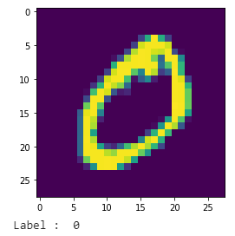
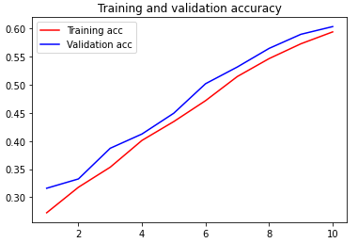
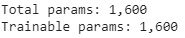
Machine Learning – Over fit / Under fit
Accuracy | Training | Validation/Testing | Possible Solutions
Under fit | Low | Low | Increase the capacity of the model

Slide 5
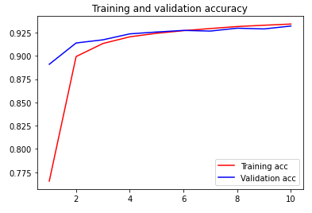
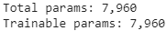
Machine Learning – Over fit / Under fit
Accuracy | Training | Validation/Testing | Possible Solutions
Just fit | High | High

Slide 6
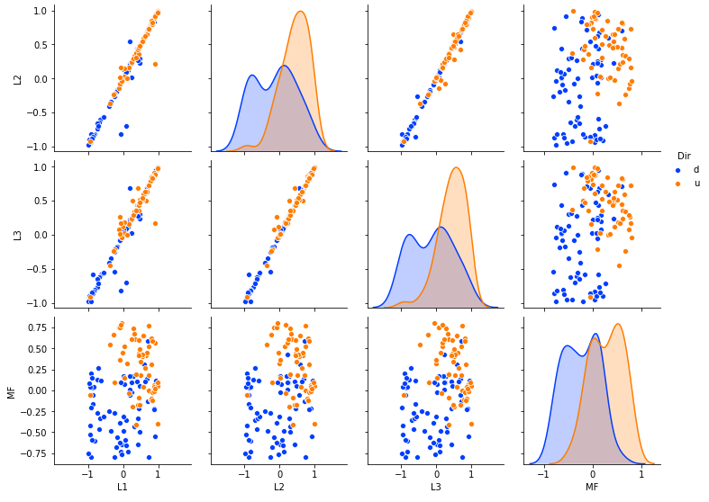
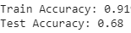
Machine Learning – Over fit / Under fit
Accuracy | Training | Validation/Testing | Possible Solutions
Over fit | High | Low | Add more data to capture enough variance or add/change the dataset features

Slide 7
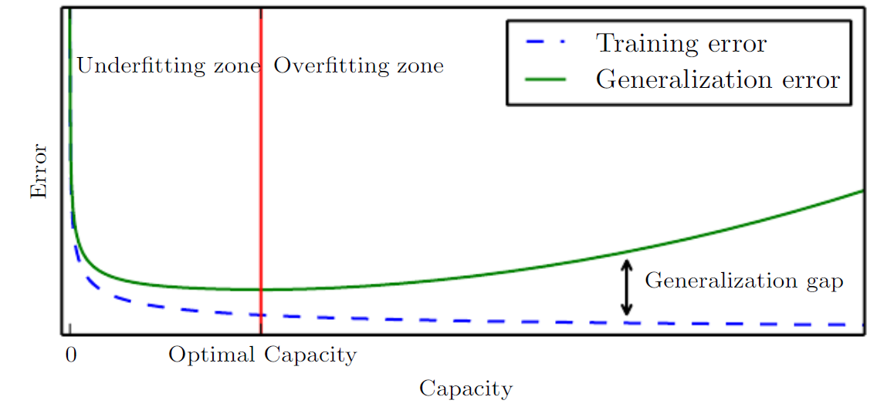
Machine Learning – Over fit / Under fit
Accuracy | Training | Validation/Testing | Possible Solutions
Under fit | Low | Low | Increase the capacity of the model
Over fit | High | Low | Add more data to capture enough variance or add/change the dataset features
Just fit | High | High

Slide 8
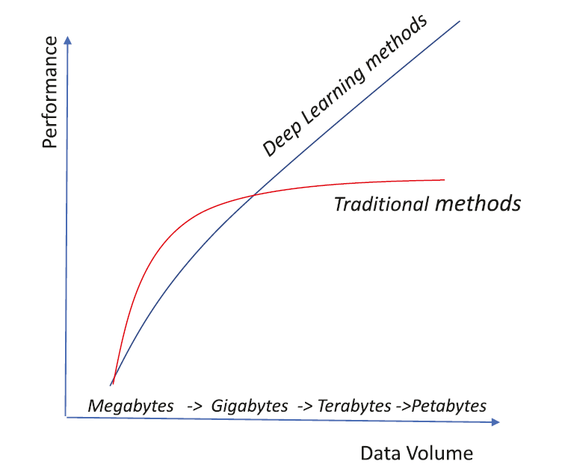
Deep Learning vs Other Machine Learning
Deep learning tend to have a lot of parameters, hence requires sufficiently large volume of data to train and more computation power
When the data volume is less, traditional methods tend to perform better that deep-learning ones. However, when the data volume is huge, the deep-learning method wins over traditional methods. (Hence Deep Learning is more scalable)
Ref: The Number of Hidden Layers

Slide 9
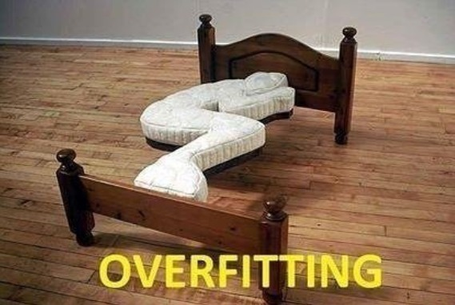
Deep Learning vs Other Machine Learning
Deep Learning model can scale easily and with thousands or million parameters to model. Great power comes great responsibility…….

Slide 10
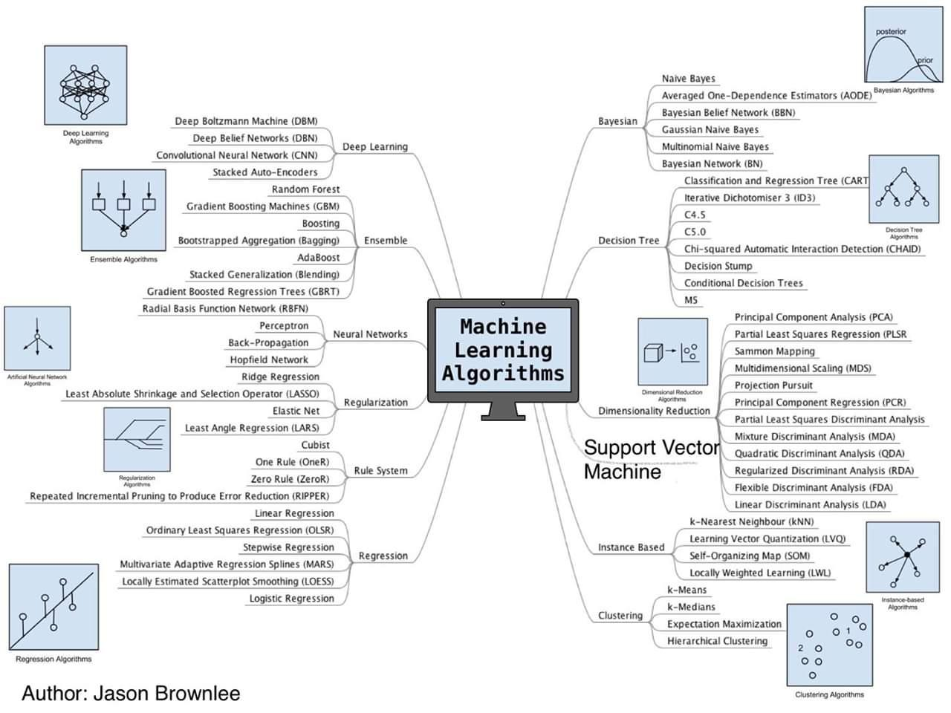
Summary of the Algorithms

Slide 11
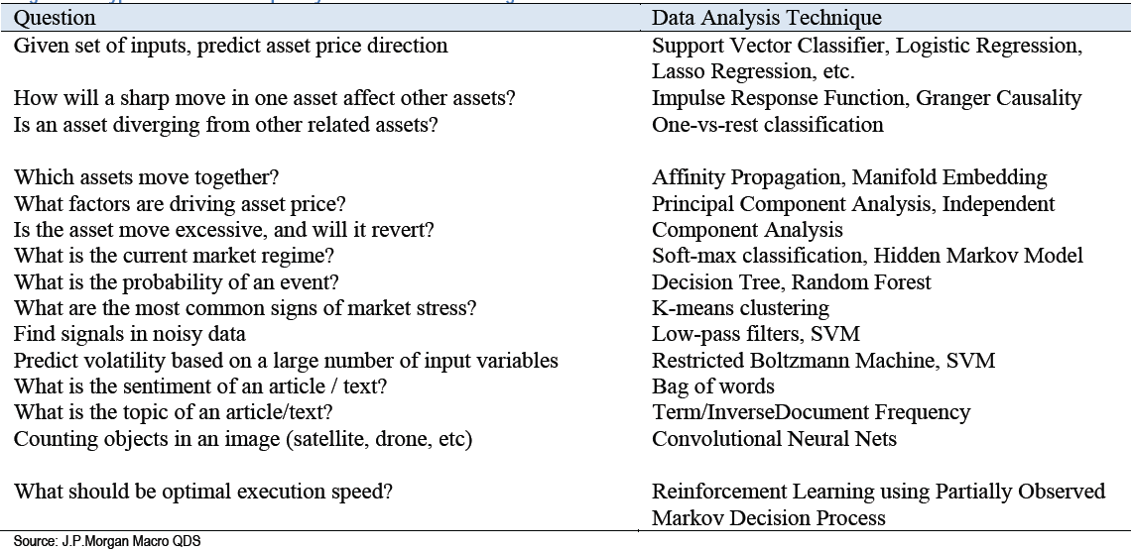
Summary of the Usages

Slide 12
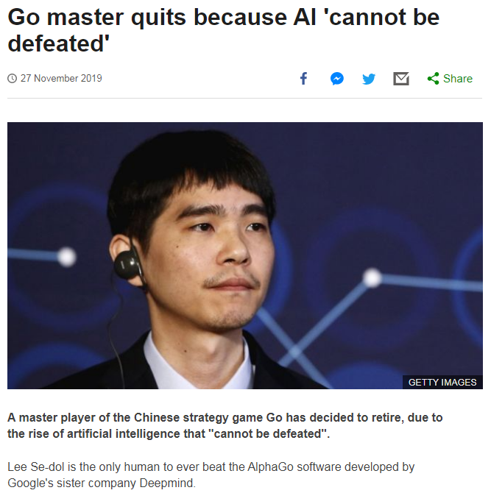
Reinforcement Learning

Slide 13
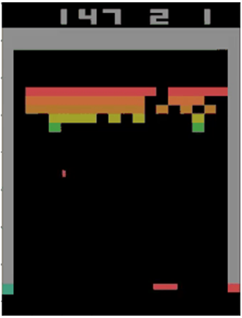
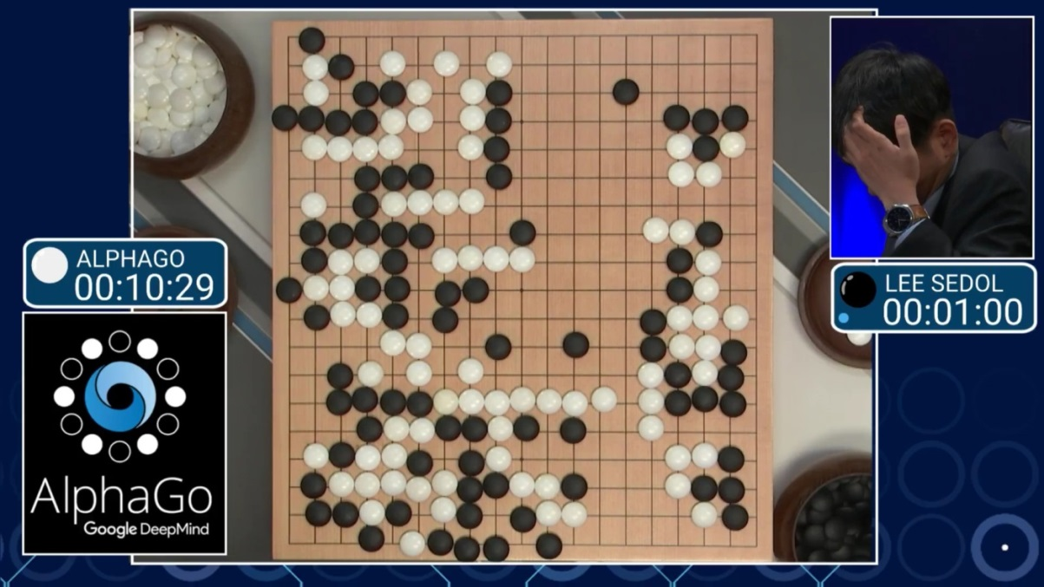
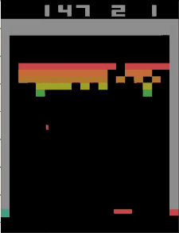
Reinforcement Learning
https://cs.stanford.edu/people/karpathy/convnetjs/demo/rldemo.html
Tunneling !

Slide 14

Reinforcement Learning
Software agents to take actions in an environment so as to maximize some notion of cumulative reward to achieve the objective.
The feedback (rewards or punishments) can be delayed.
Explore vs. Exploit: should the algorithm explore new alternative actions that may maximize the final reward, or stick to the established one that maximizes the immediate reward.
Value learning (state, values) vs Policy learning

Slide 15
Reinforcement Learning
Q-function learns all the possible combination of the states and actions, hence the size of the Q-table (state, values) will be very big
Train the neural network to approximate the Q-function
DeepMind’s work on Deep Q-Network -uses a deep neural network that takes an image (the state) in to estimate the Q-value for all possible actions.)
Deep Reinforcement Learning: https://www.youtube.com/watch?v=lvoHnicueoE
Quotes: Sometimes, we talk about reinforcement learning, which is a little bit like how you might train a puppy. The dog does something good, and you go, “Good dog.” It does something bad, and you go, “Bad dog.” And over time, the dog figures out what it did well, what it did poorly, and hopefully does more of the good things.
Supervised Learning -> Relationship (Classification/Regression); RL learns Action (Policy)

Slide 16
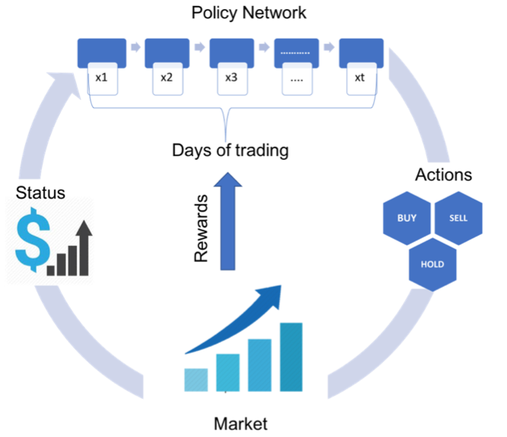
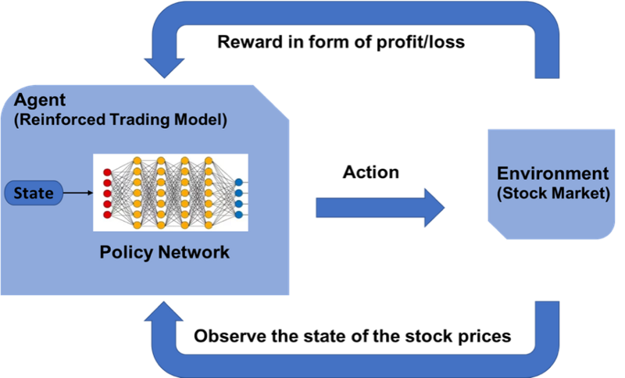
Reinforcement Learning on Trading

Slide 17
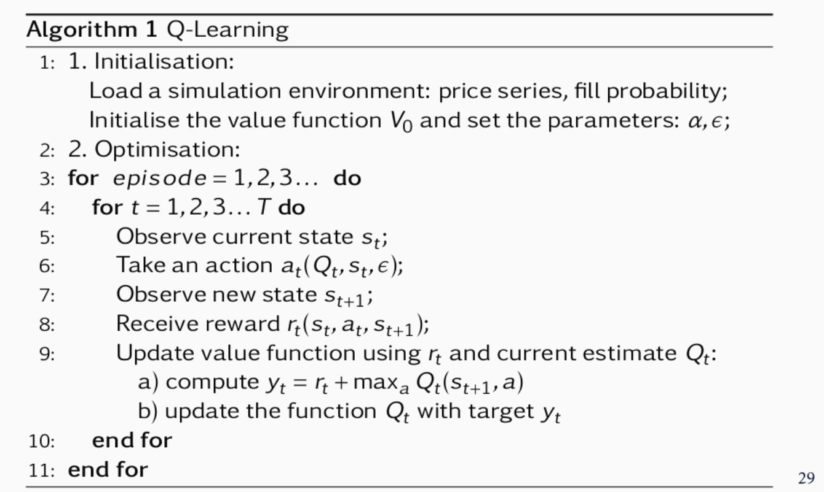
Reinforcement Learning on Trading
JP Morgan LOXM
Learns to perform the best action (choose optimal price, duration and order size ) based on market conditions
State: price series, spread cost, fill probability, size placed, elapsed time, %progress
Rewards: immediate rewards (price spread) and terminal (end of episode) rewards like completion, order duration and market penalties (negative rewards that punish the agent)

Slide 18
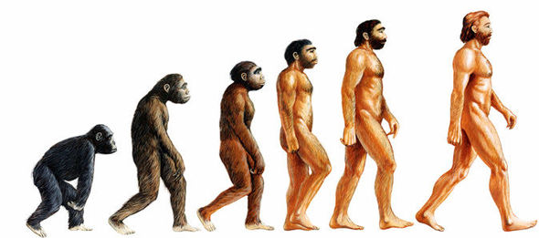
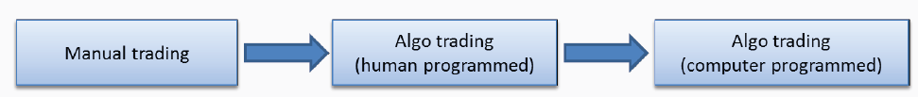
Reinforcement Learning on Trading
AI Traders -> Repeatedly Doing Backtest -> Find the Optimal Strategies
It is a very black box approach and may not be welcomed by compliance and regulators

Slide 19
Roles of Humans and Machines
Short term trading: (e.g. high frequency, market making) humans already play a very small role.
Medium term investment horizon: machines are becoming increasingly relevant. It can quickly analyze news feeds and tweets, process earnings statements, scrape websites, and trade on these instantaneously. These strategies are already eroding the advantage of fundamental analysts, equity long-short managers and macro investors.
Long term horizon: machines will likely not be able to compete with strong macro and fundamental human investors (yet !?). Machines will likely not do well in assessing regime changes (market turning points) and forecasts which involve interpreting more complicated human responses such as those of politicians and central bankers, understanding client positioning, or anticipating crowding.

Slide 20
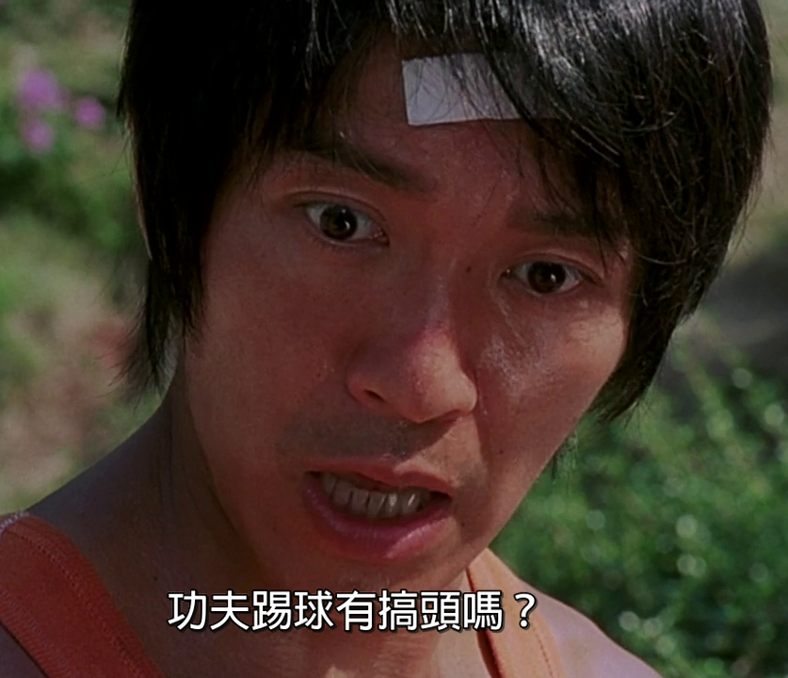
Trading Strategies - Background
AI + Trading = Success ?

Slide 21
Trading Strategies - Biz
Quant (contrast to value/fundamental) trading based on AI and Machine Learning
Productizing the trading strategies into a global AI volatility fund to seek intraday profits in futures, options, ETF and other low transaction cost instruments which are listed products in global exchanges
In 2014, Man Group bought Boston-based hedge fund Numeric for USD$325 million at 8 times Price-Earnings-Ratio
https://dealbook.nytimes.com/2014/06/19/man-group-to-buy-bostons-numeric-holdings/

Slide 22








Trading Strategies - Biz
Competitor Analysis
Stock Picking
Robinhood
Brokerage
Asset Manager
Target
ETF

Slide 23
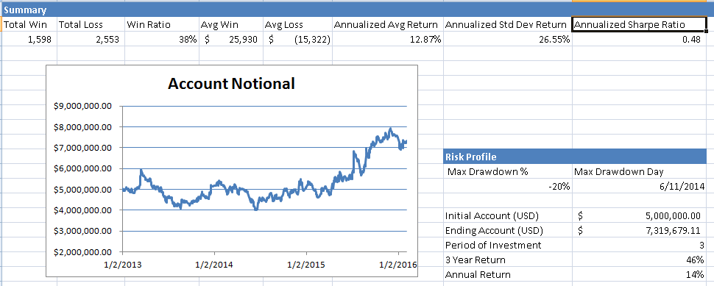
Trading Strategies – Fee Structure
2% management fee of net asset value (NAV) and 20% performance fee of fund’s profit (aka 2/20). Performance fee is subjected to a high water mark scheme. No hurdle rate (min. rate of return before collecting performance fee) is applicable.

Slide 24
Trading Strategies – Fee Structure
High-Water Mark: the highest peak in value that an fund. It prevents performance-based fees charged twice for the same amount of performance. Example: $500,000 of 20% Performance fee
First month, the fund earns a 15% return; 20% fee on this $75,000 gain, which equates to $15,000. At this point, the high-water mark $575,000
Second month, loses 20% to $460,000.
Third month, earns a profit of 50%: $460,000 to $690,000.
With a high-water mark in place, all gains from $460,000 to $575,000 are disregarded.
But gains above the high-water mark are subject to the performance-based fee. 20% on the gains from $575,000 to $690,000, which is an additional $23,000.

Slide 25
Trading Strategies - Drivers
Rule based trading strategies is rigid and unable to adapt to new conditions as they are handcrafted by domain experts with higher difficulties in interpretation on large amount of data.
Using data-driven approach has the following advantages.
learn the rules from the data itself instead of being handcrafted beforehand
allow the discoveries of rules that suit different scenarios
the rules can be adjusted according to the changes in conditions (re-training or parameters tuning).

Slide 26
Trading Strategies - Workflow

Slide 27
Trading Strategies - Workflow
Raw Data: sourced from data providers (such IB, HKEx). It has to be comprehensive that covers different markets and across many years in order to learn the relationship and back test the trading strategies.
Data Processing: derive features from raw data (such as bid/ask spread and imbalance, queue size, short term money flow from the historical tick data). Pre-process the data, for instance, adjusting the price from corporation actions or holiday.
EDA (Exploratory Data Analysis): analyze/visualize (e.g. scatter plot) the data sets to summarize their main characteristics and relationships. Depends on the objective of the particular trading strategy, not all the features will be useful to feed into the machine learning models. Together with our domain knowledge on market dynamics and microstructure, we apply the EDA techniques to pick the relevant features.

Slide 28
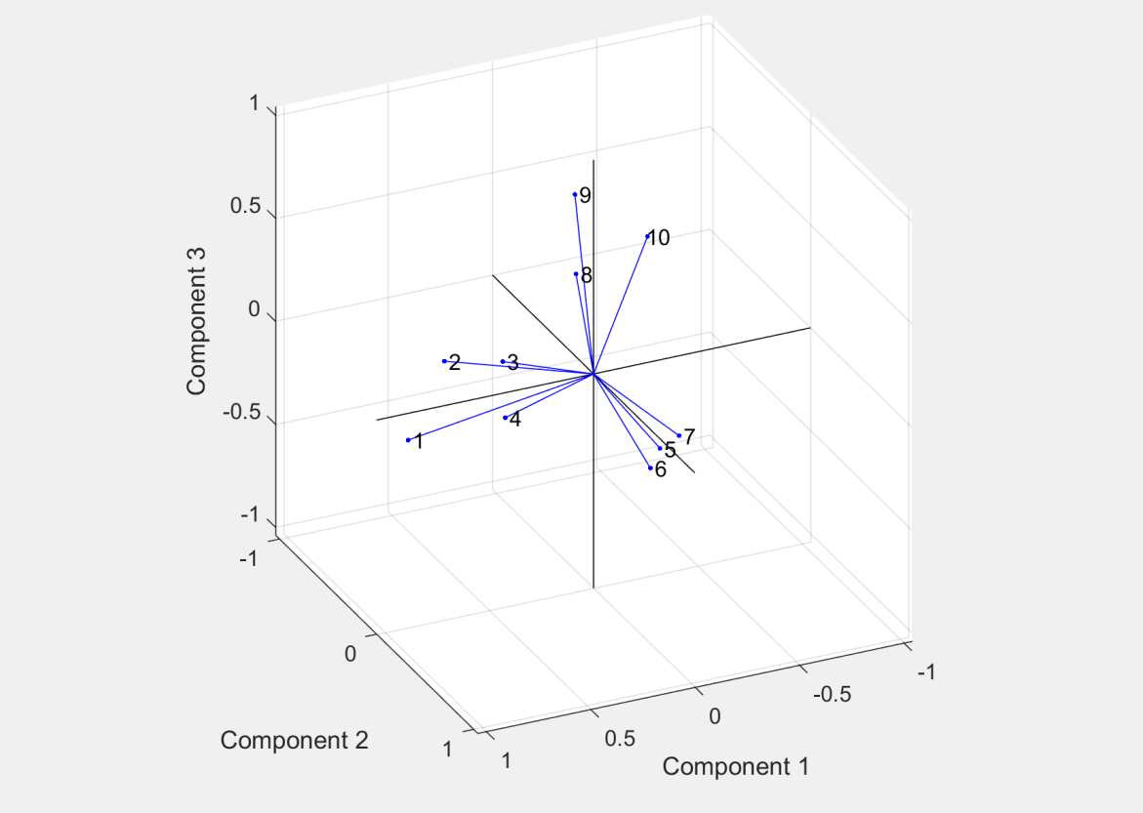
Trading Strategies - Workflow
Feature Extraction / Clustering: feature extraction/clustering to systematically group or reduce the feature set which simplify the underlying model and ease the computation time. It will also decrease the chance of over-fitting.
This example is using Factor Analysis to group 10 different features to 3 important components. Therefore, instead of feeding 10 features to the machine learning model, we only need to use 3 components (linearly combined features) which are already captured the essential

Slide 29
Trading Strategies - Workflow
Back Testing: use historical data to evaluate the trading strategies performance, P&L and Win Ratio
Prevention of Data Snooping Bias: is a common mistake in trading strategy simulation where an algorithm makes a forecast based on information in the future, as full price history is already made available to the simulation. One way is to replay market data tick by tick into the algorithmic trading engine. The idea is to mimic real life trading, where one have no knowledge about what’s going to happen next, and would need to make decision with only data available up to this moment in time. Replay market data tick-by-tick is slow (e.g. running with one year data).
Market Impact: it is hard to model the market impact caused by your trade as it’s obviously not happened historically !

Slide 30
Trading Strategies - Risk Management
Maintain sustainability of the trading strategies, and to prevent catastrophic events (such as program bugs or extreme market conditions) that could cause significant loss to the portfolio. This is to guarantee that the trading strategies do not lose more than a prefixed amount or a percentage of Asset Under Management.
Strategy Stop Loss: on a per strategy basis, every time the strategy goes into a position, a stop loss order is automatically created. The strategy can only tolerate a certain amount of unrealized loss, before the position is automatically cut.
Daily Stop Loss: on an overall portfolio level, once the daily loss reaches the daily stop loss limit, the system is forbidden to establish any new positions, and any existing positions is automatically closed.

Slide 31
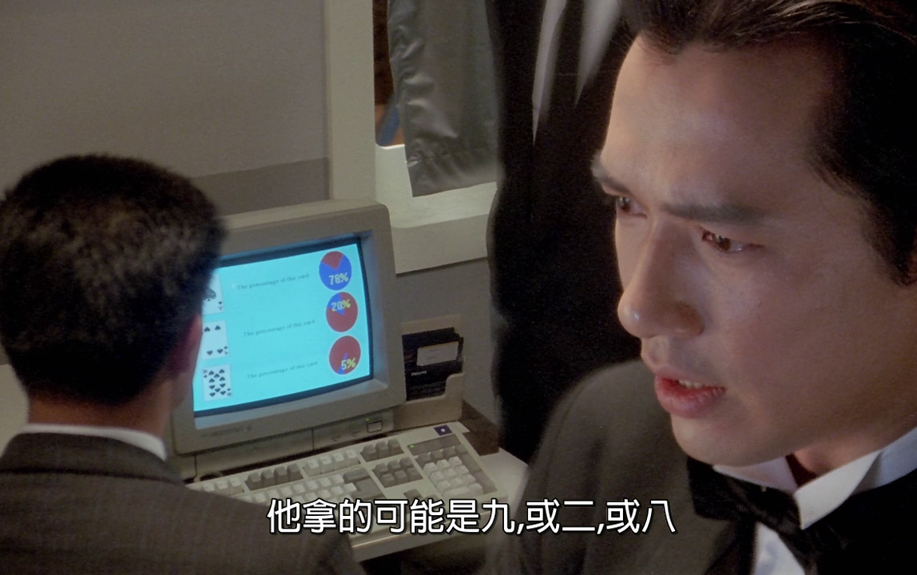
Trading Strategies – Trading Charts

Slide 32
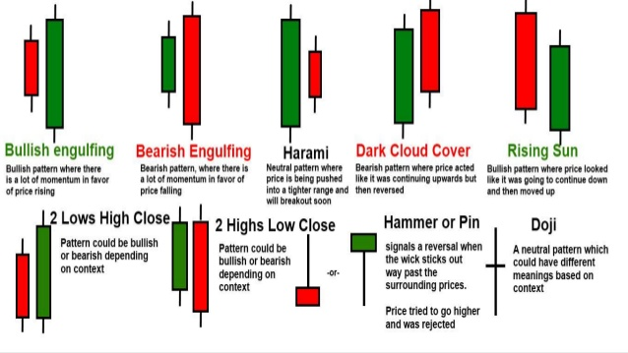
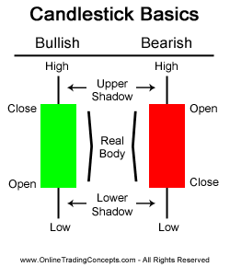
Trading Strategies – Trading Charts
Mimic human traders on analyzing charts like Candle Sticks, RSI and Moving average. Generate useful analytics such as classifying the strength of certain signals, spotting anomaly and learning the underlying patters for future predictions.

Slide 33
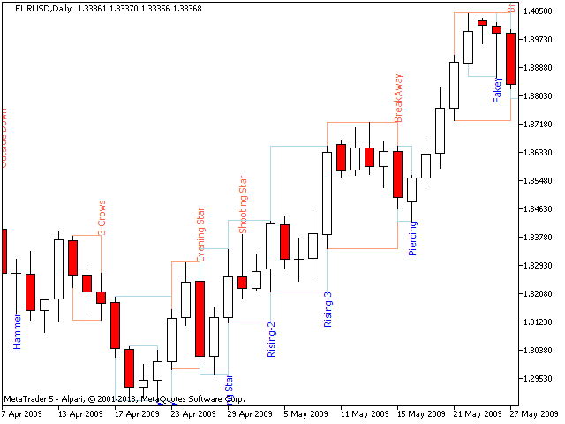
Trading Strategies – Trading Charts
Put Candle Sticks in time series to spot trends
Depends on the duration of the trend (short-term trend or long-term trend), each candle bar can a 1-min bar, 5-min, 15-min etc. and up to 1-year

Slide 34
Trading Strategies – Trading Charts
Analysis on graphs done by artificial intelligence (AI) has the following advantages over the traditional approach of raw data
acts as a way of pre-processing from raw data as graphs can provide better summary while filtering out noises
good way to compress the data which is defined as dimension reduction, allowing “a picture is worth thousand of words”
encodes domain knowledge such as feature engineering when generating the trading graphs
mimics how human processes information by visually capturing the spatial and temporal relationships.
AI can learn more and faster

Slide 35
Trading Strategies - Trading Charts
Modules: Chart Generator, CNN Clusterer, Classifier, CNN Visualizer and Deep-Q trading.
Traning Data & Features
CNN Visualizer
Historical Tick Data
Chart Generator
CNN Clusterer
Classifier
Deep-Q trading
Human Label

Slide 36
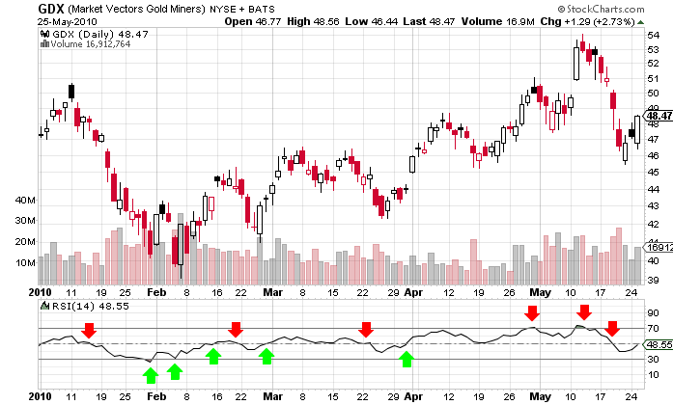
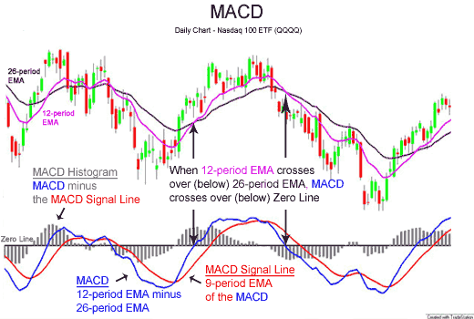
Trading Strategies - Trading Charts
Chart Generator: read from raw financial data / feature set to generate trading charts. Has plug-in of different modules to generate different types of charts. By inputting raw historical data such as volumes and prices into Chart Generator, it will convert the data into corresponding technical graphs such as MACD, RSI apart the Candle Sticks.

Slide 37
Trading Strategies - Trading Charts
CNN Clusterer: categorizes the charts into different categories which has similar patterns. Currently, it requires human to label (e.g. sudden move, flat tail etc.) the main characteristics from the clustered group of the output charts.
CNN techniques will be applied to cluster the graphs into different groups and to train the model to classify the graphs for similar patterns (unsupervised learning)
CNN learns the spatial relations of images which are the features that will be used for clustering the graphs. CNN also learns the hierarchical relation of the graphs for classification purpose.
CNN Visualizer: visualization techniques to see the captured patterns in different layers of the CNN model and hence, help to understand the models.

Slide 38
Trading Strategies – Reinforcement Learning
Challenges in Supervised Learning on price movement:
No liquidity in the best order book levels, network latencies, and fees, none of which the supervised model could take into account.
It does not imply a policy: what if the price had moved down? Would you have sold? Kept the position and waited? What if the price had moved up just a little bit and then moved down again? What if we had been uncertain about the prediction, for example 65% up and 35% down? Would you still have bought? How do you choose the threshold to place an order?
Need a rule-based policy that takes as input your price predictions and decides what to actually do: Place an order, do nothing, cancel an order, and so on

Slide 39
Trading Strategies – Reinforcement Learning
Reinforcement Learning
http://www.wildml.com/2018/02/introduction-to-learning-to-trade-with-reinforcement-learning/
https://github.com/ucaiado/QLearning_Trading
Instead of needing to hand-code a rule-based policy, Reinforcement Learning directly learns a policy.
Trained directly in Simulation Environments
Ability to model other agents

Slide 40
Trading Strategies – Reinforcement Learning
Deep Q trading:
reinforcement learning (RL) and Q-learning, can learn decision rules directly with reasonable rewards/punishments
has been successfully applied to some challenging tasks like game playing and robot motion.
automatically determine what position to hold at each trading time.
Deep Stock Representation Learning: From Candlestick Charts to Investment Decisions

Slide 41
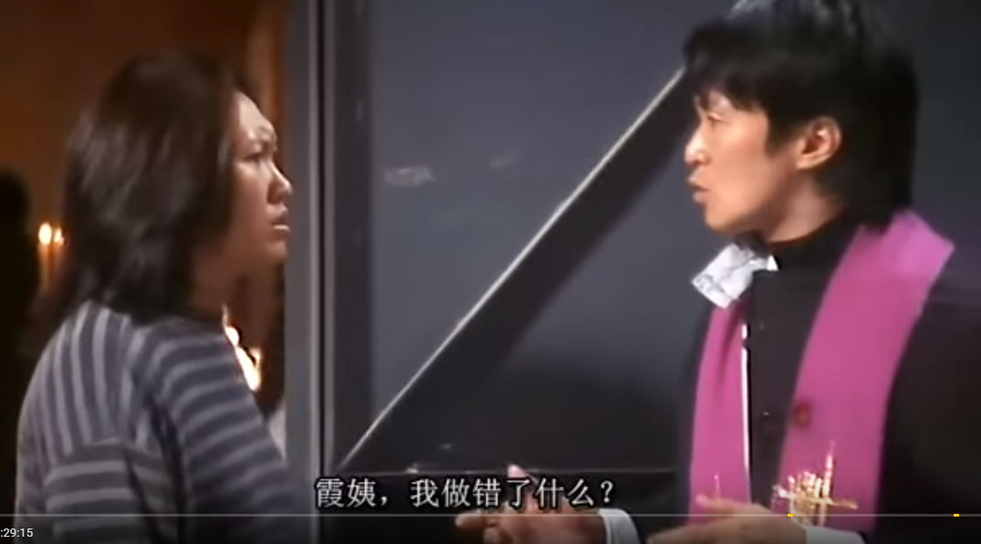

Challenges

Slide 42
Challenges
Historical market data cost: used for model training and back testing. It is expensive to buy historical data (especially tick data). But Deep learning is a data hungry model and need a lot of data to discover meaningful signals
Infrastructure cost: low latency trading requires fast (and hence expensive) market data (e.g. colo exchange market data feed caused ~HK 80K per month) and trading infrastructure
Transaction costs: quant trading has high number of transactions that amount to large commission fees that eats up the profile

Slide 43
Challenges
Transaction cost is a big part in Quant trading because of the frequency of buying and selling instruments that needs to pay the fees
HK Stock Transaction Costs:
Brokerage Fee: 0.25% of transaction amount or minimum HK$100 (depends on brokers and some claim to be free)
Transaction Levy: 0.0027% of transaction amount
Trading Fee: 0.005% of the transaction amount
Stamp duty (collected for HKSAR Government): 0.1% of transaction
HK Index Future HK$15 per contract offered by IB
(Note: To realize the profile (or loss), it involves buy/sell and hence needs to counts the above charges twice)

Slide 44
Challenges
Face Recognition vs World Cup Prediction vs Weather Forecast
Compare Weather forecast to Stock Price forecast as both are time-series based
 | Weather | Stock Price
Seasonality | Yes, strong auto-correlation to due seasonal patterns | History repeat itself?
Causality | Temperature, air pressure, humidity etc. | Historical price, news, sentiment?
Visibility | Can measure the temperature, humidity etc. | Cannot measure investors decisions
Signal to noise | High | Low
Regime Switching | Global Warming | Bull/Bear, Macroeconomics, technologies

Slide 45
Challenges
Data and Features: Too less data (not able to explain) may suffer curse of dimensionality (e.g. SVM kernel function) where the prediction lack statistical significance. Or too much data (noise?) and financial data is traditionally with very low signal-to-noise

Slide 46
Challenges
Correlation vs Causality: correlation does not imply causation. If two stocks move in a correlated fashion, it doesn’t necessarily mean stock A causes the Stock B to move. It could both be under another common factor.
Example: HSBC and Bank of China is correlated (banking sector)
Scenario 1: Interest Rate rise
Scenario 2: Bank of China has a solid earning
Stephen Cucchiaro (3edge): “No scientist or engineer would ever use correlation analysis for analyzing a nonlinear complex system of interrelated variables,” he says, “because those correlations are often nothing more than statistical coincidences, not true cause-and-effect relationships.”

Slide 47

Challenges
Overfitting: in-sample training gives high accuracy (false hope) but out-sample accuracy drops significantly.
Marcos López de Prado: “Machine learning algorithms will always identify a pattern, even if there is none. The algorithms can view flukes as patterns and hence are likely to identify false strategies.

Slide 48
Challenges
Stochastic (Randomness): confused supervised learning model. Is trading really a random walk or we need more features (factors) to train the model
Prediction timeframe: longer term subjects to (multiple) regime switching. Shorter term is more accurate, but is less profitable due to the transaction costs to realize the profile. However, it can be used as entry/exit signals for the alpha generating strategy.
Data Processing Time: spend 80% of (active) time to prepare the data correctly and which is not too much fun (training models also needs time and but just let the computer run while going for lunch)

Slide 49
Challenges
Time and cost for model training: machine learning (especially Deep Learning) is a black box and sometimes difficult to reason the training results and require trial and errors (e.g. hyper-parameters tuning). The time to train and re-train a model with large data set is very time consuming and require extra expense to rent the powerful machine (with many GPUs) in the cloud
Market Dynamics: your own action will cause certain market impact but it is not part of the historical data
Financial products: financial instruments (especially derivative products) are linked or correlated in a complex fashion that adds volatility or uncertainties

Slide 50
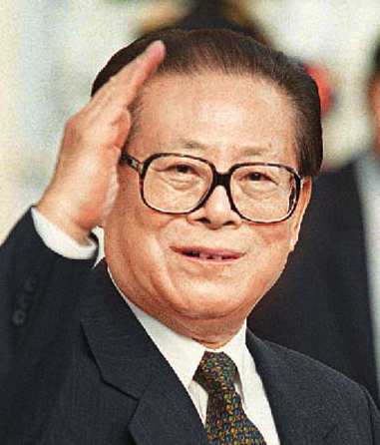
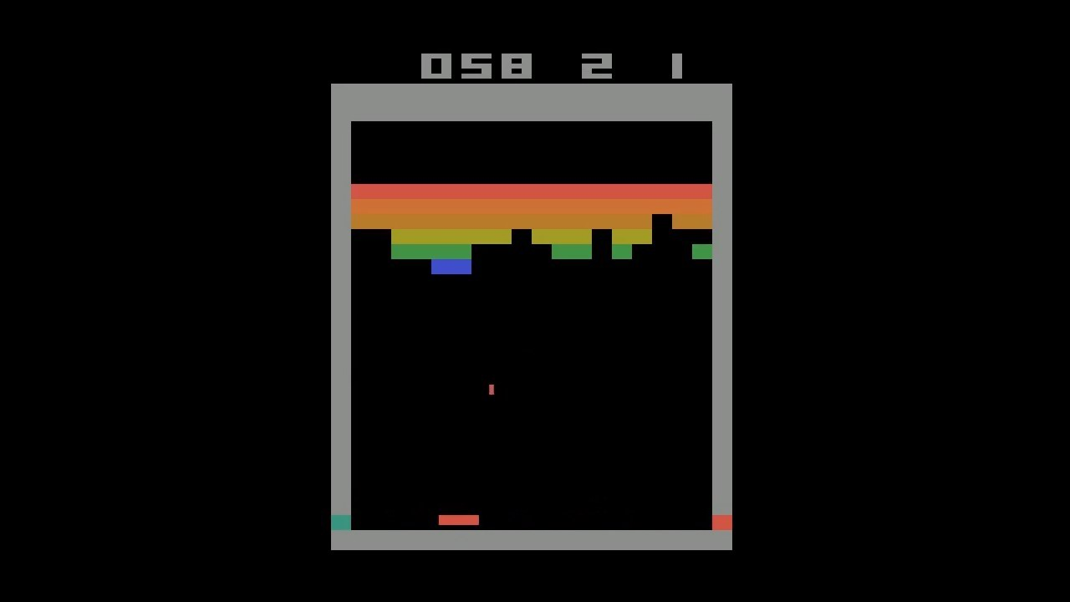

Challenges
Overly simplified : our Reinforcement Learning strategies are too simple
Too simple sometimes naive
Our Model
JP Morgan LOXM

Slide 51
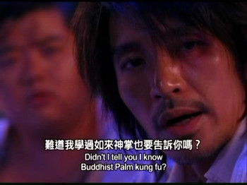
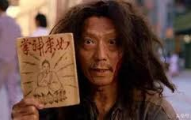
Challenges
Confidential: unlike software, no open source profitable strategies. Successful strategies are kept secrecy.
Research papers are usually proof of concepts.

Slide 52
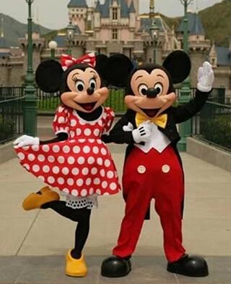
Challenges
Psychological : develop a profitable trading strategy is an all-or-nothing exercise and which create mental pressure
Constantly question the meaning of our work as we’re not contributing to the society positively (e.g. making people happy)

Slide 53
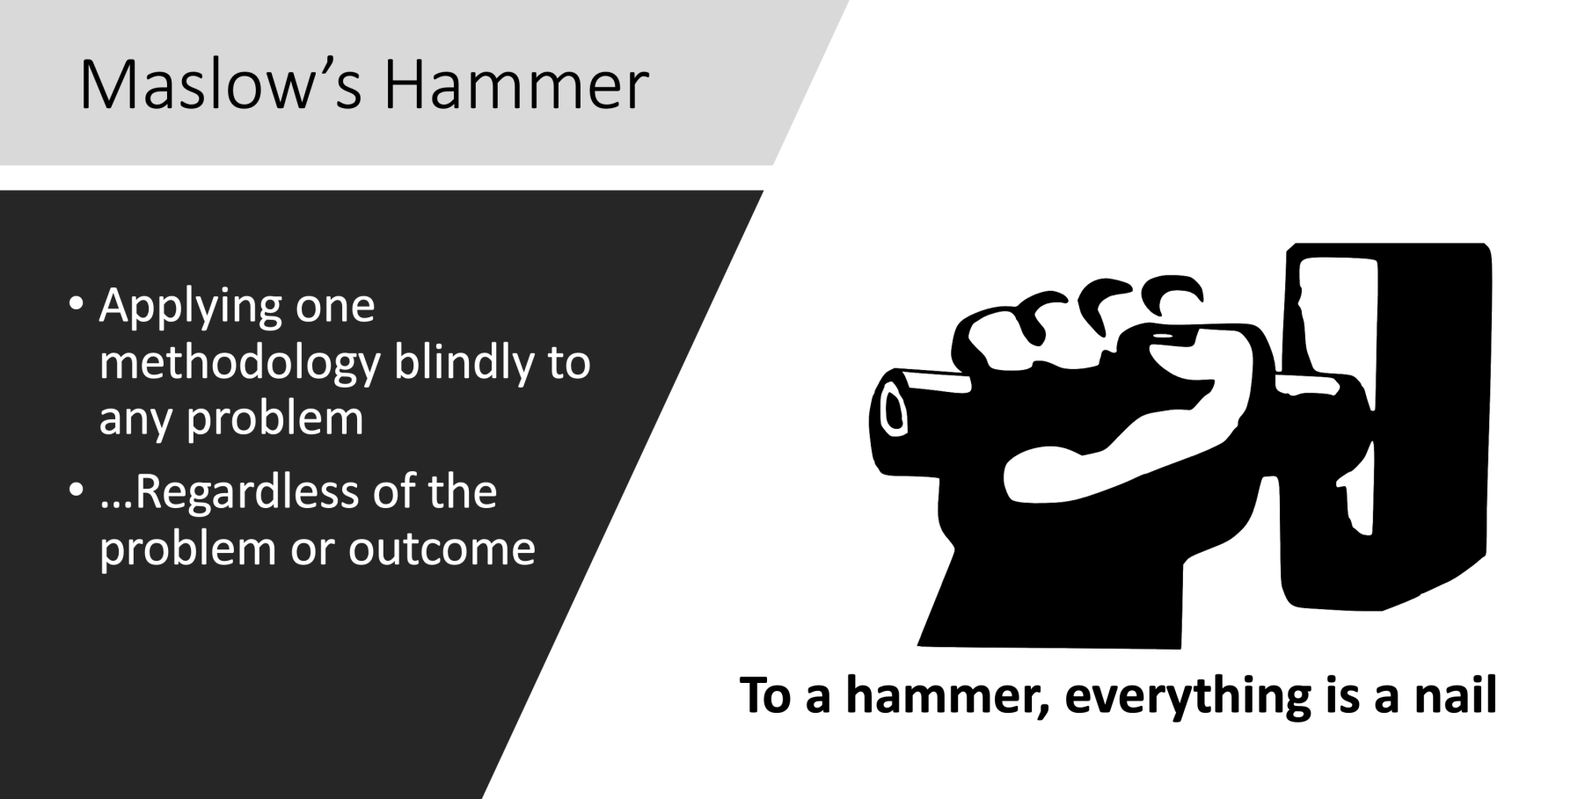
Challenges
Maslow’s Hammer: Deep Learning is cool and let’s just apply it to trading

Slide 54
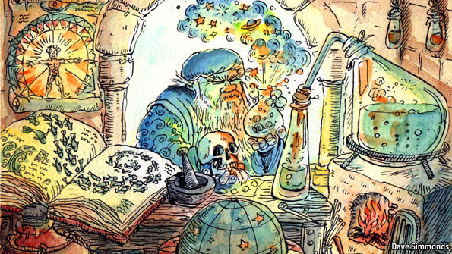
Challenges
Thought AI is Modem Alchemy (煉金術), put something (data) there and then pray it works.

Slide 55
Limitation of Deep Learning
Everything is a vector (is a point in a geometric space). Each layer in a deep learning model operates one simple geometric transformation on the data that goes through it.
This complex transformation attempts to maps the input space to the target space, one point at a time. This transformation is parametrized by the weights of the layers, which are iteratively updated based on how well the model is currently performing.
A key characteristic of this geometric transformation is that it must be differentiable, which is required in order for us to be able to learn its parameters via gradient descent. Intuitively, this means that the geometric morphing from inputs to outputs must be smooth and continuous—a significant constraint.

Slide 56
Limitation of Deep Learning
Turning meaning into vectors, into geometric spaces, then incrementally learning complex geometric transformations that map one space to another. All you need are spaces of sufficiently high dimensionality in order to capture the full scope of the relationships found in the original data
Deep learning models do not have any understanding of their input, at least not in any human sense.
Our models can only perform local generalization, adapting to new situations that must stay very close from past data, while human cognition is capable of extreme generalization, quickly adapting to radically novel situations, or planning very for long-term future situations.

Slide 57
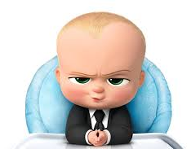
Limitation of Deep Learning
What’s that mean,
in layman term please

Slide 58
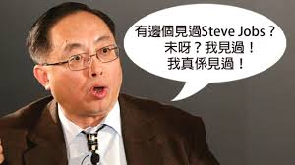
Deep Learning requires many Data
Deep Learning has seen the data, it really has seen the data
Not human-like reasoning (cannot generalize well, NOT一理通,百理明 -> need to see many variations). It’s just a very good “mapper” (mapping input to output)
Because of that, it needs a lot of data to learn a specific task (compare this to how a people learn to cross the road)

Slide 59
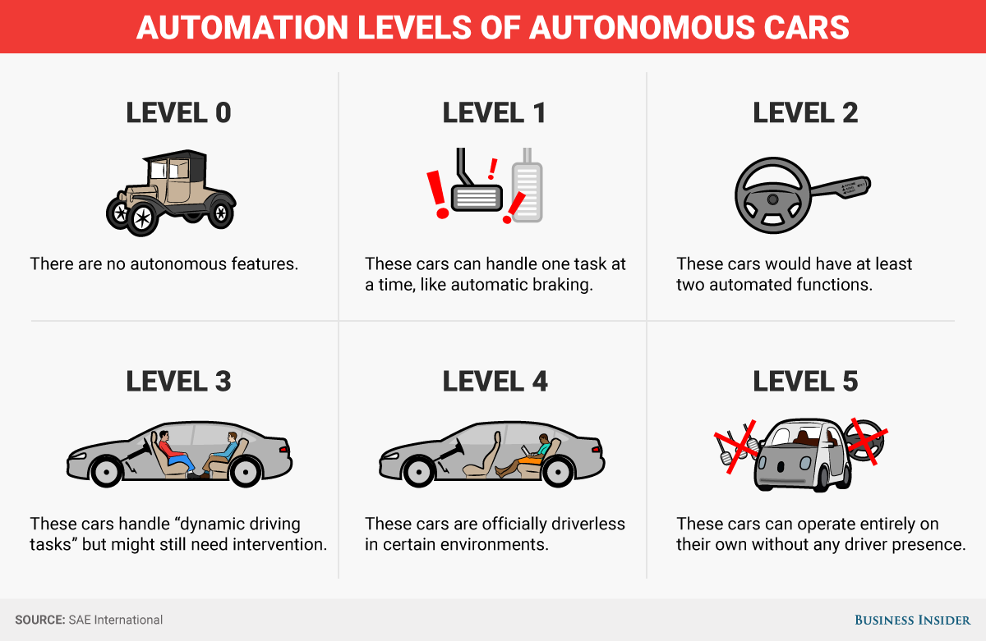
Data labelling – Telsa Self Driving Car

Slide 60
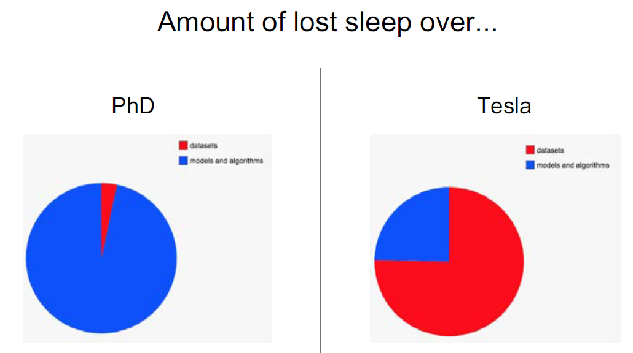
Data labelling – Telsa Self Driving Car
Based on “Building the Software 2.0 Stack – by Andrej Karpathy, May 10, 2018 (page 51 – 75)

Slide 61
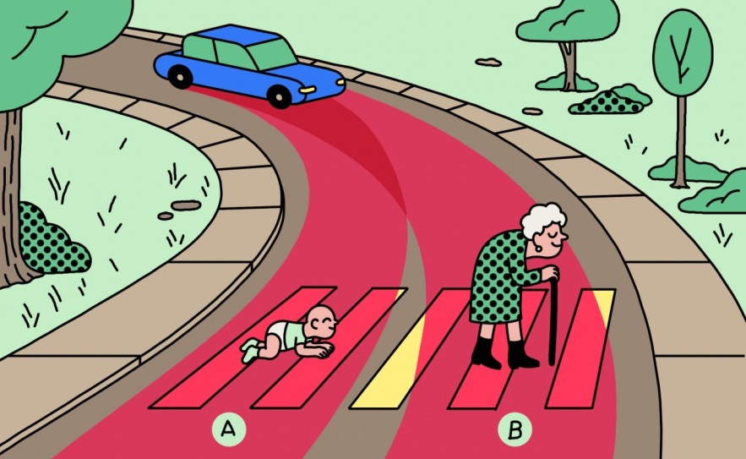
Data labelling – Telsa Self Driving Car
Challenges
Data & Algo biased:
Should a self-driving car kill the baby or the grandma?
Driverless Cars Will Have to Break the Law
Responsibility: in case of breaking the law, who should go to jail (the car owner or the car company)
Less tolerant on machine than human
2019: Fanlan bus incident
2017: Taipo road incidents

Slide 62
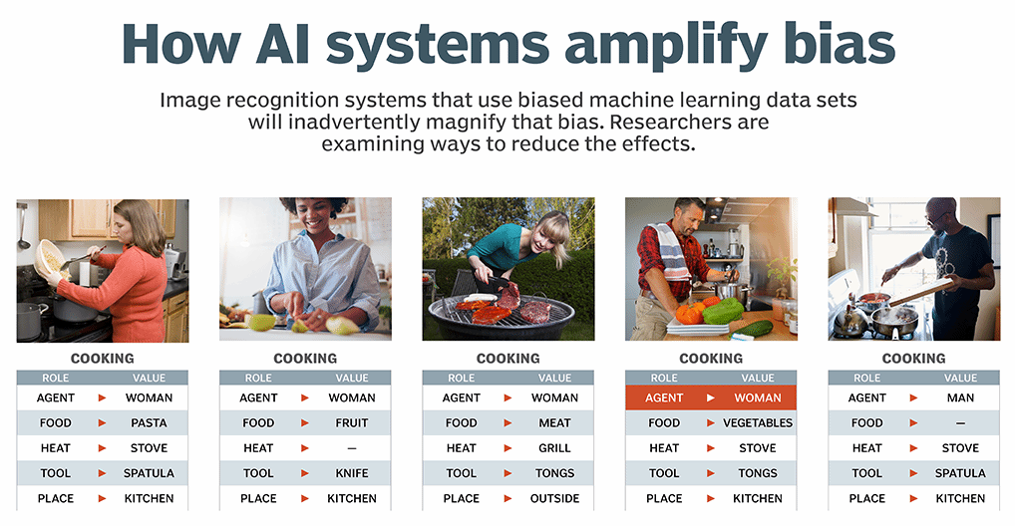
Data labelling – Other Data Bias Examples
Racial Bias and Gender Bias Examples in AI systems
Lawmakers Can't Ignore Facial Recognition's Bias Anymore
Cancer spotting AI image recognition is only trained on fair-skinned people. They worked more effectively on male vs. female, and on lighter vs. darker skin. The “error rates were as low as 1% on males and as high as 35% on dark females.”

Slide 63
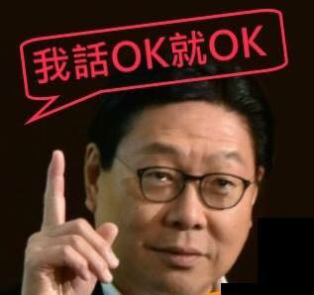
Deep Learning is a Black-Box
Deep learning tend to have a lot of parameters, however, it is hard to explain why the model adapt to certain weights. It’s called black-box model
Deep Learning Said OK is OK

Slide 64
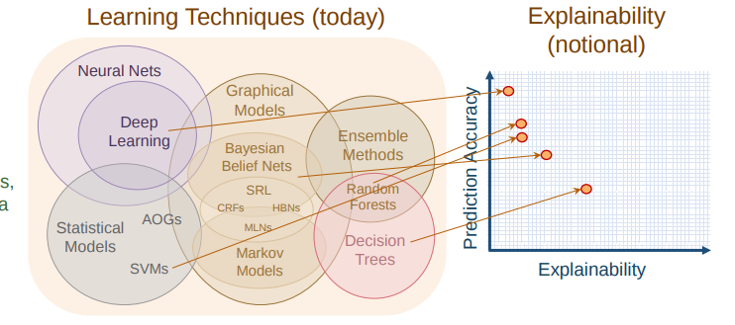
Deep Learning is a Black-Box
Hard to explain the decision. Other models (decision trees) is easier to explain and interpret

Slide 65
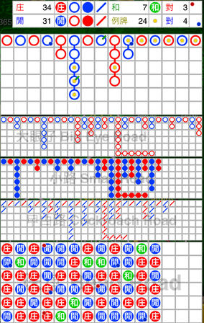
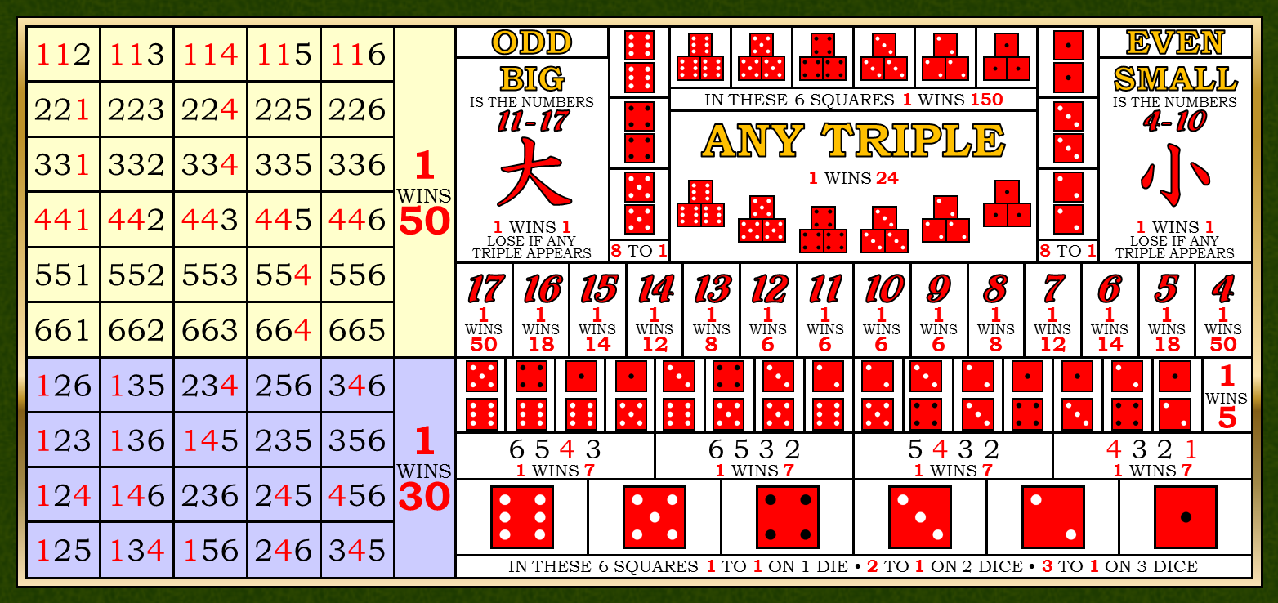
Thoughts and Discussions
Regime Shifting: are trends/patterns stationary and bound to be repeating?

Slide 66

Expert Thoughts on Algo Trading and AI
Deep Learning with Python book p.224
Markets and Machine Learning
Some readers are bound to want to take the techniques we’ve introduced here and try them on the problem of forecasting the future price of securities on the stock market (or currency exchange rates, and so on). Markets have very different statistical characteristics than natural phenomena such as weather patterns. Trying to use machine learning to beat markets, when you only have access to publicly available data, is a difficult endeavor, and you’re likely to waste your time and resources with nothing to show for it.
Always remember that when it comes to markets, past performance is not a good predictor of future returns —looking in the rear-view mirror is a bad way to drive. Machine learning, on the other hand, is applicable to datasets where the past is a good predictor of the future.

Slide 67


My Thoughts on Algo Trading and AI
More Ingredients: Sentiments, Satellite Images..
Better Tools: NLP, Deep/ Reinforcement Learning
Still needs (domain) knowledge, skills and experience

Slide 68

My Thoughts on Algo Trading and AI
AI in trading & investment are in early stage
Trading requires the right features (domain knowledge and insights)
May not directly used in trading strategies but used it processing alternative data (satellite images, news sentiment)
Need to define a workable objective (not just predict price up/down). The objective could be just a sub-components of the overall strategy.
Pure AI and data-driven Algos will be hard!

Slide 69

My Thoughts on AI
People are (much) smarter but machines work (much much) harder. Is it a race between rabbit & tortoise -> but tortoise cannot fly (limitation of the model)
3 idiots are better than one smart guy (三個臭皮匠，勝過一個諸葛亮) vs “One vs Ten” (一個打十個)
AGI (Artificial General Intelligence): machine is not real human-like intelligence “yet” but are you going to achieve true Intelligence?
Biologist Emerson M. Pugh once said, “If the human brain were so simple that we could understand it, we would be so simple that we couldn’t”

